Slide 1
Django - Working with Models
AMI PATEL

Slide 2
Storing data in a database is a common practice in most web applications.
In a Django project, it involves working with Django models. We will create a database model (for example, blog posts and movies) and Django will turn this model into a database table for us.
powerful built-in admin interface that provides a visual way of managing all aspects of a Django project

Slide 3
Contents
• Creating our first model
• Managing migrations
• Accessing the Django admin interface
• Configuring for images
• Serving stored images
• Adding a movie model to admin

Slide 4
Creating our first model
Django model basics:
• Each model is a class that extends django.db.models.Model
• Each model attribute represents a database column
• With all of this, Django provides us with a set of useful methods to create, update,
read, and delete (CRUD) model information from a database.

Slide 5
/movie/models.py
from django.db import models
class Movie(models.Model):
title = models.CharField(max_length=100)
description = models.CharField(max_length=250)
image = models.ImageField(upload_to='movie/images/')
url = models.URLField(blank=True)
To refer model fields https://docs.djangoproject.com/en/4.0/ref/models/fields

Slide 6
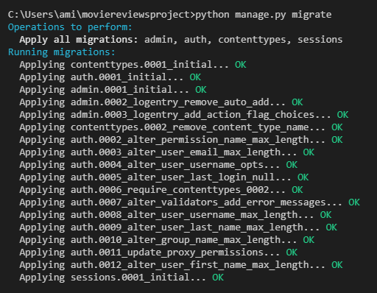
Installing pillow
we are using images, we need to install Pillow https://pypi.org/project/Pillow/ , which adds image processing capabilities to our Python interpreter.
pip install pillow
Managing migrations
Migrations allow us to generate a database schema based on model code. Once we make changes to our models (such as adding a field and renaming a field), new migrations should be created. In the end, migrations allow us to have a trace of the evolution of our database schema.
python manage.py migrate

Slide 7
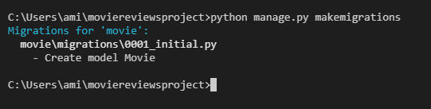
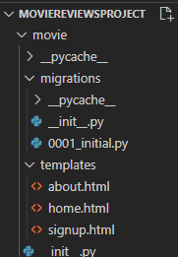
create the migrations for the movie app. We will run the makemigrations command in the Terminal.
python manage.py makemigrations

Slide 8
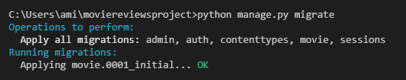
we need to build the actual database with migrate (python3 manage.py migrate),
which executes the SQL commands in the migrations file. Currently, it
uses the default SQLite database engine, but you can integrate your own DB system by
modifying the moviereviews/settings.py file.
python manage.py migrate
In summary, each time you make changes to a model file, you have to run the following.
python manage.py makemigrations
python manage.py migrate

Slide 9
Accessing the Django admin interface
To access our database, we have to go into the Django admin interface. Remember that there is an admin path in /moviereviews/urls.py?
Django has a powerful built-in admin interface that provides a visual way of managing all aspects of a Django project – for example, managing users and making changes to model data.
With what username and password do we log in to Admin? We will have to first create a superuser in the Terminal.
python manage.py createsuperuser
Enter user name, email and password
If you wish to change your password later, you can run the following commands.
python manage.py changepassword <username>

Slide 10

Currently, our movie model doesn't show up in admin. We need to explicitly tell Django what to display in it. Before adding our movie model in admin, let's first configure our images.
Configuring for images
moviereviews/settings.py and add the following at the bottom of the file:
At the top of the file, add the following:

Slide 11
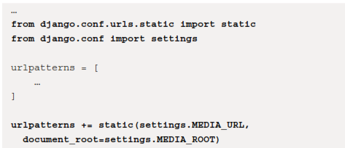
Serving the stored images
/movie/urls.py the following:

Slide 12
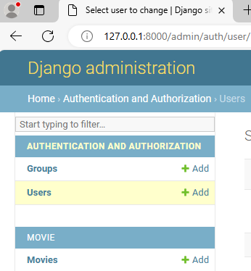

Adding a movie model to admin
/movie/admin.py, and register our model with the following:

Slide 13
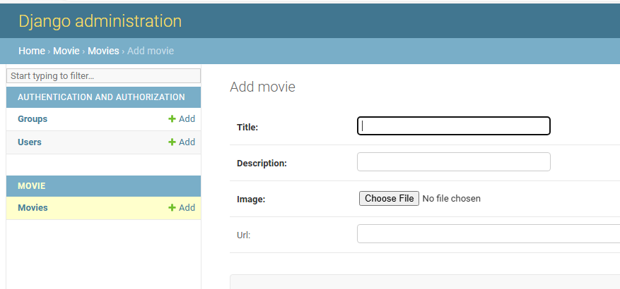
Try adding a movie object by clicking on +Add. You will be brought to the Add movie
Note that Url is not in bold, as we marked it as optional back in models.py, url = models.URLField(blank=True). The other required fields are in bold.

Slide 14
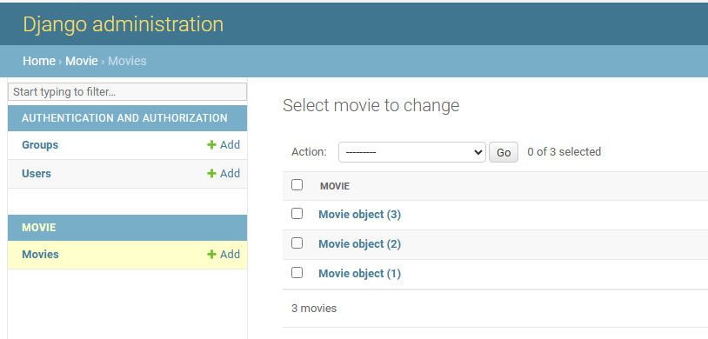
Try adding a movie and hit Save. Your movie object will be saved to the database and reflected in the admin page as shown in Figure :
You can also see the movie image in /moviereviews/media/movie/images/<image file>.jpg.

Slide 15
Displaying Objects from Admin
Previously, we learned how to store data in a database. In this chapter, we will collect and display database information.
we will be covering the following topics:
• Listing movies
• Using the card component
• Implementing a search
• Adding a news app
• Listing news

Slide 16
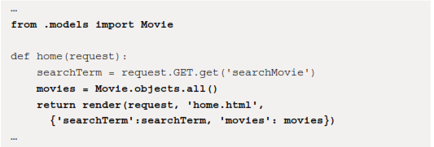
Listing movies
In movie/views.py, add the following in bold:

Slide 17
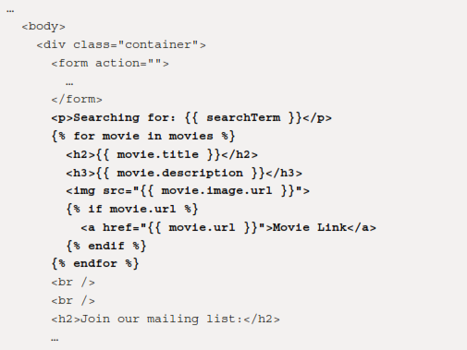
Make changes in to
/movie /templates/home.html
Using a for loop in the Django templating language, we loop through movies, with movie acting as a temporary variable to hold the element for the current iteration.
Note that we enclose code in {% … %} template tags. We use {{ … }} to render variables such as a movie's title, description, and image URL.

Slide 18

Because a movie URL is optional, which means it can be null, we check whether it has
a value with {% if movie.url %} and, if so, render a <a> href to the movie URL:
We presented a practical use of both the for and if template tags. You can find a more complete list of template tags here: https://docs.djangoproject.com/en/4.0/ref/templates/language/#tags.

Slide 19
Let's further improve the look of our site by using the card component from Bootstrap to display each movie(https://getbootstrap.com/docs/5.1/components/card/)home.html
<p>Searching for: {{ searchTerm }}</p>
<div class="row row-cols-1 row-cols-md-3 g-4">
{% for movie in movies %}
<div v-for="movie in movies" class="col">
<div class="card">
<img class="card-img-top" src="{{ movie.image.url }}" />
<div class="card-body">
<h5 class="card-title fw-bold">{{ movie.title }}</h5>
<p class="card-text">{{ movie.description }}</p>
{% if movie.url %}
<a href="{{ movie.url }}" class="btn btn-primary">
Movie Link
</a>
{% endif %}
</div>
</div>
</div>
{% endfor %}
</div>
<br />
<br />
<h2>Join our mailing list:</h2>

Slide 20
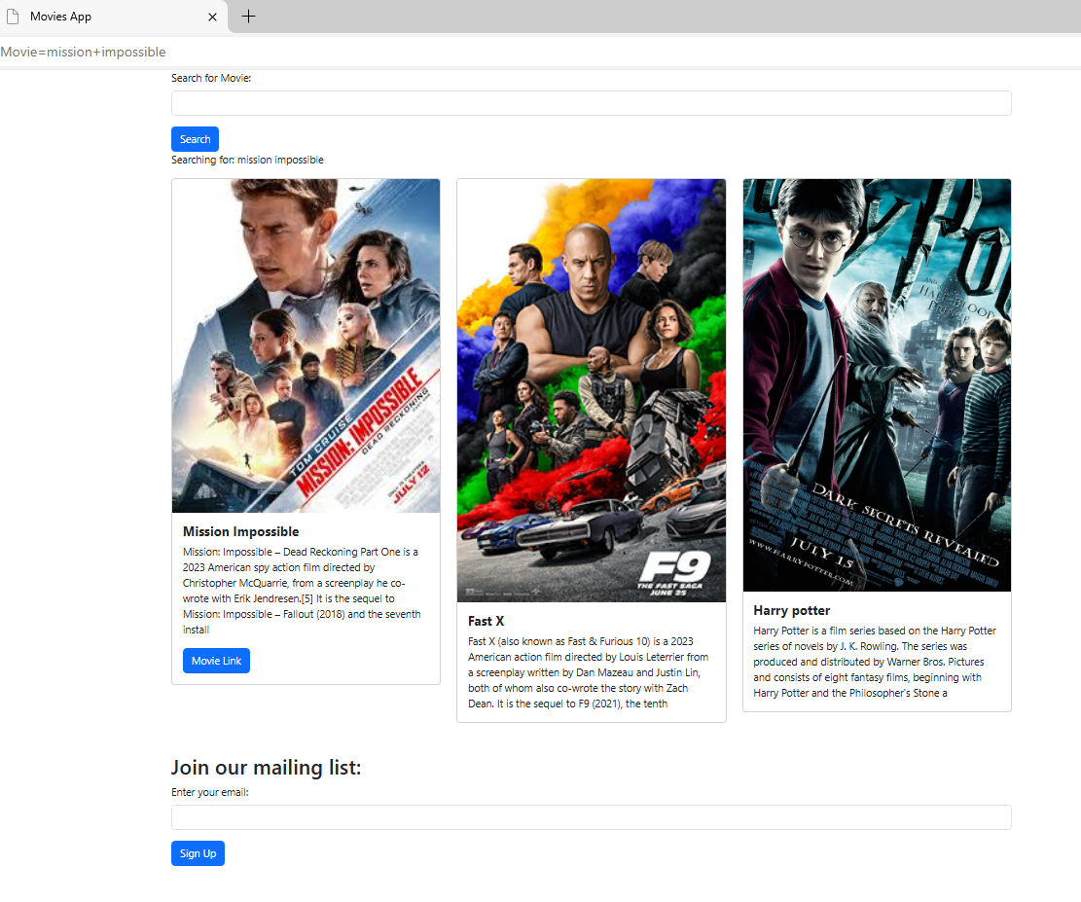

Slide 21
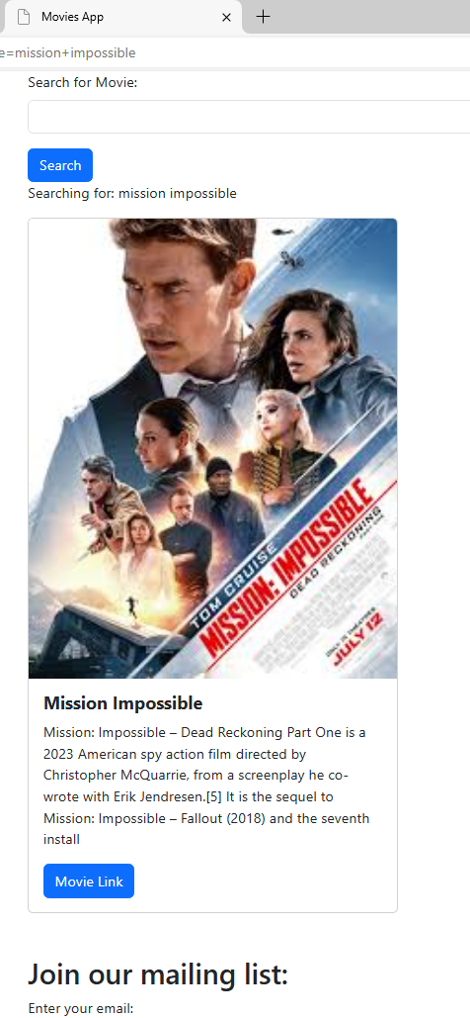
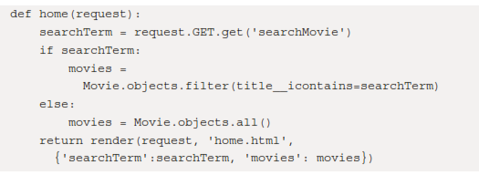
Implementing a search
Implement def home in /movie/views.py with the following

Slide 22
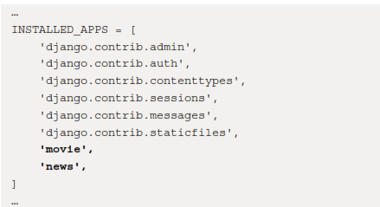
Adding a news app
python manage.py startapp news
/moviereviews/settings.py
Each time we add an app, we have to tell Django about it by adding it to moviereviews/settings.py:

Slide 23
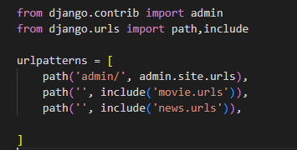
we have to add the path to news in /moviereviews/urls.py.

Slide 24
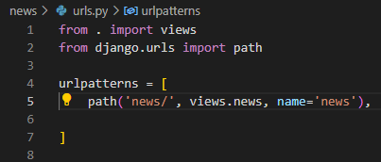

In /news, create a new file, urls.py, with the following:
in /news/views.py, add the def news function:

Slide 25
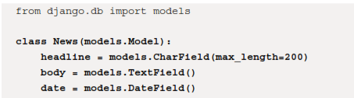
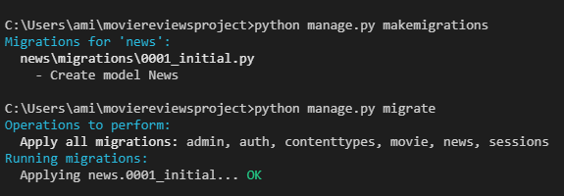
News model
In /news/models.py, create the model with the following:
make migrations with the following:
python manage.py makemigrations
python manage.py migrate

Slide 26

register the news model by going to /news/admin.py and adding the following in bold:

Slide 27
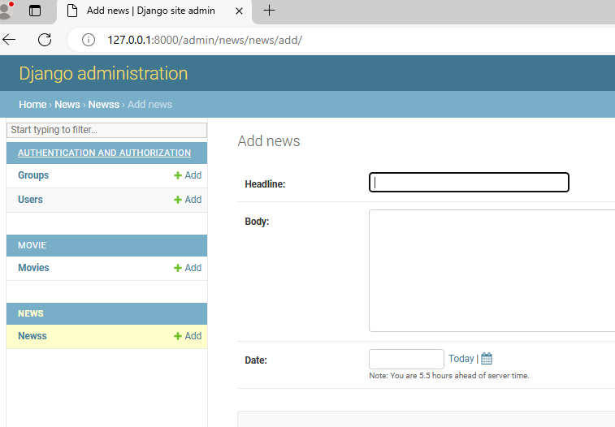

Slide 28
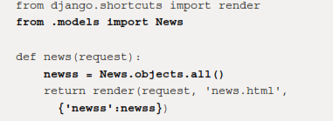
Listing news
In /news/views.py, add the following in bold:

Slide 29
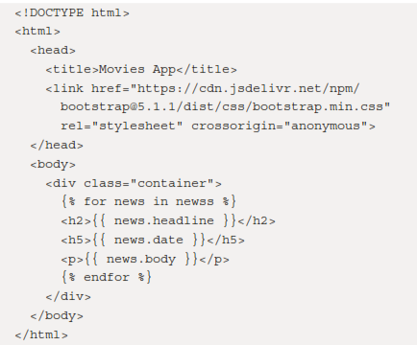
/news/templates/news.html, display the news objects with the following code:

Slide 30
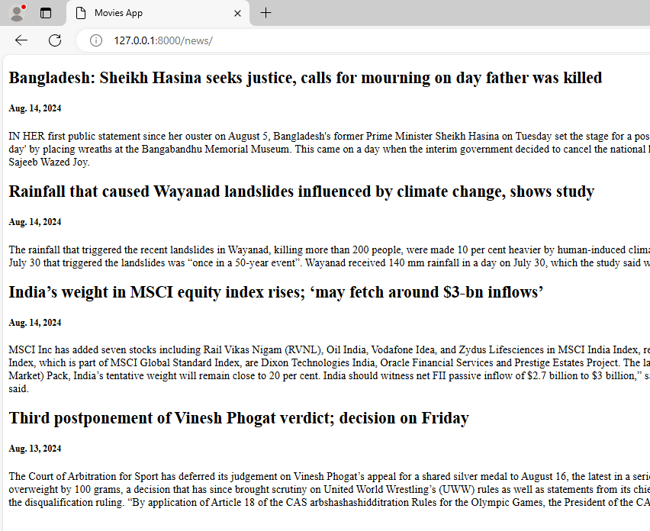
Now, try adding some news objects in admin. When you visit http://localhost:8000/news/

Slide 31
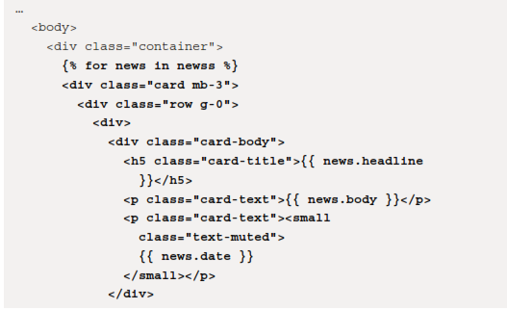
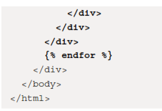
We should also improve the look of the news site with the Bootstrap Horizontal Card component (https://getbootstrap.com/docs/5.1/components/card/#horizontal). In /news/templates/news.html, replace the for loop markup and make the following changes in bold:

Slide 32
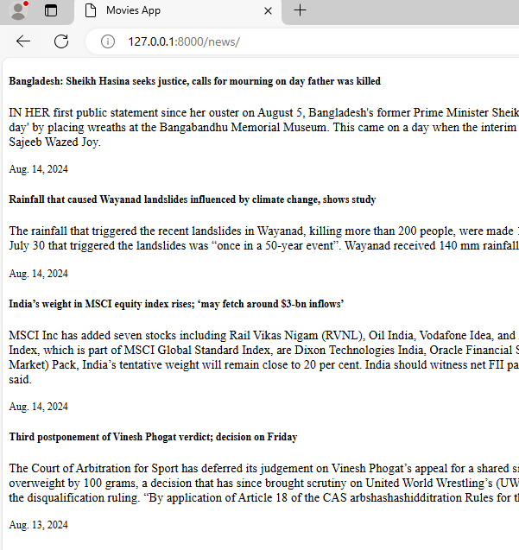

Slide 33
Thank you

